Slide 1
Chapter 4
Mathematical Expectation

Slide 2
Section 4.1
Mean of a Random Variable

Slide 3
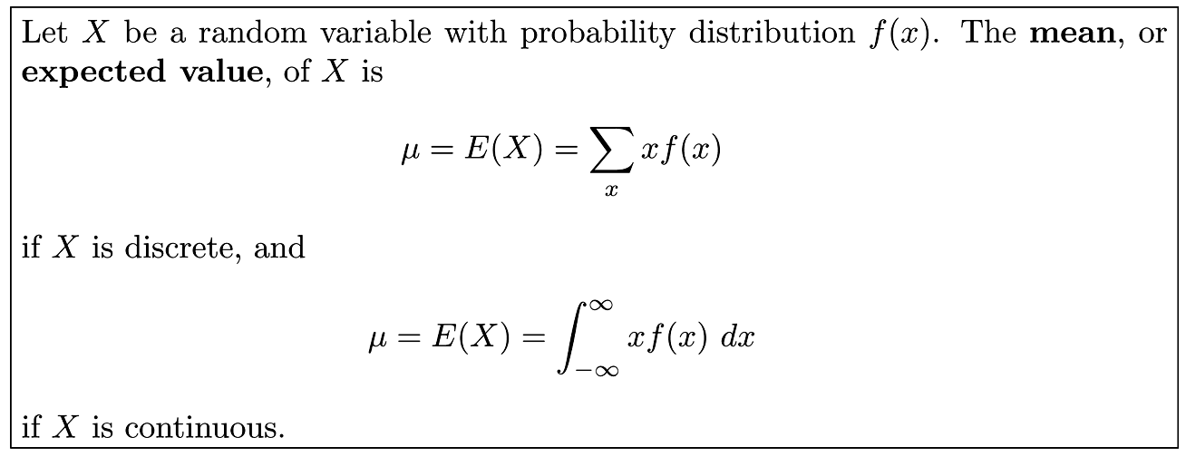
Definition 4.1

Slide 4
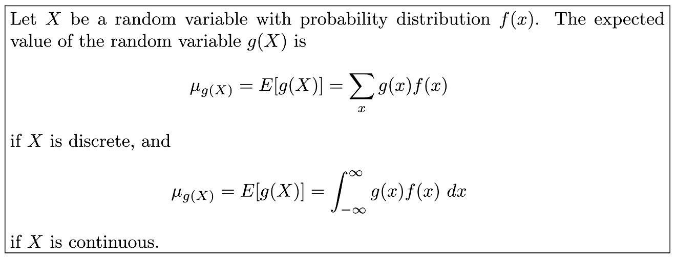
Theorem 4.1

Slide 5
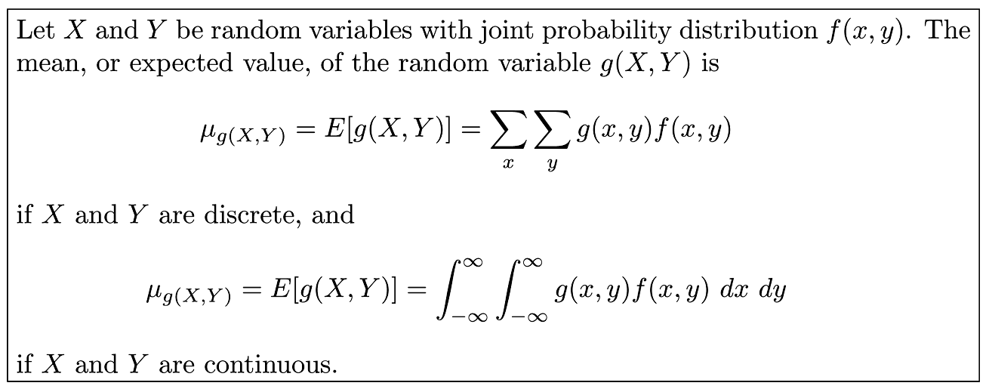
Definition 4.2

Slide 6
Section 4.2
Variance and Covariance of Random Variables

Slide 7
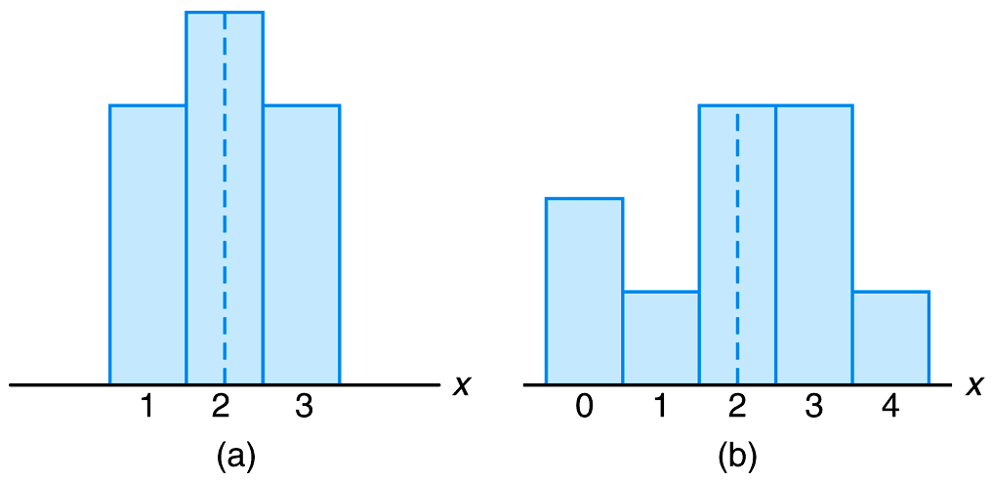
Figure 4.1 Distributions with equal means and unequal dispersions

Slide 8
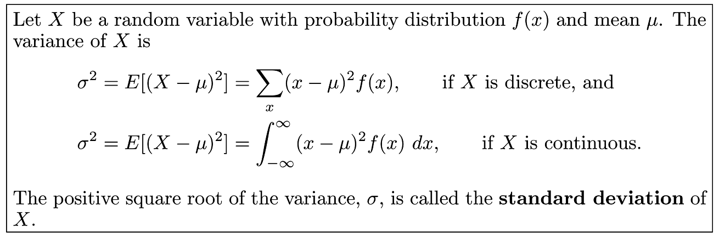
Definition 4.3

Slide 9
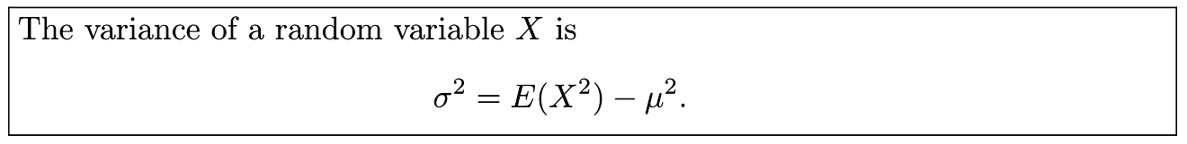
Theorem 4.2

Slide 10
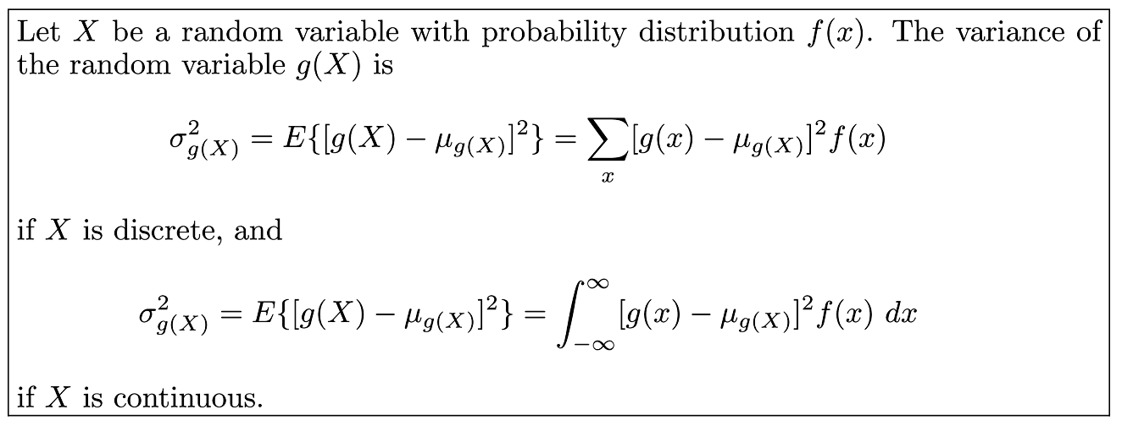
Theorem 4.3

Slide 11
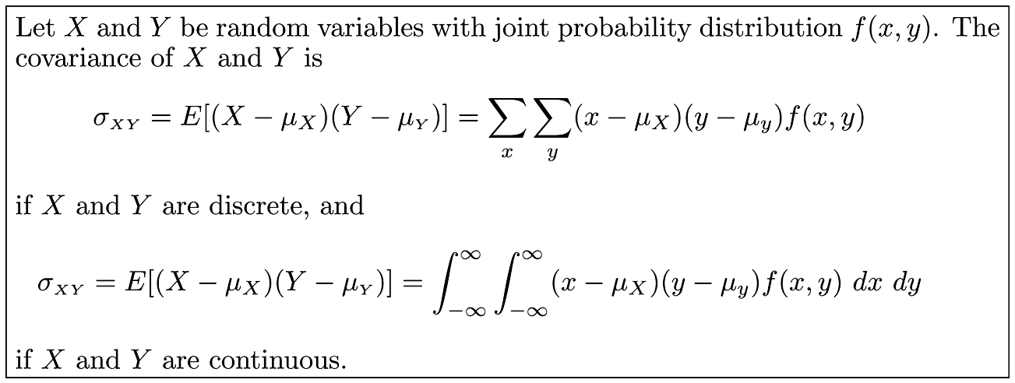
Definition 4.4

Slide 12
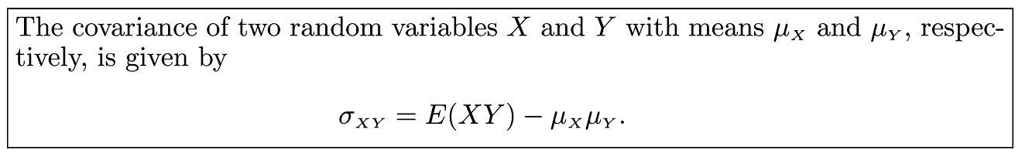
Theorem 4.4

Slide 13
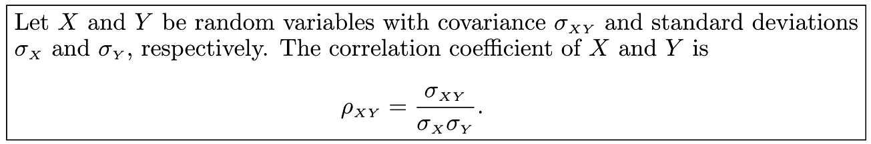
Definition 4.5

Slide 14
Section 4.3
Means and Variances of Linear Combinations of Random Variables

Slide 15
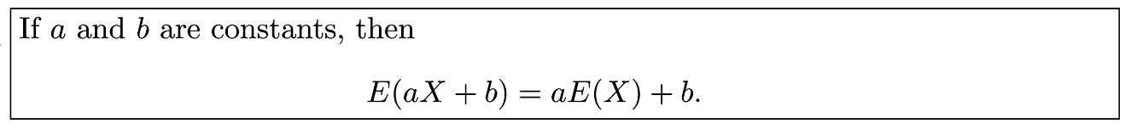
Theorem 4.5

Slide 16
Corollary 4.1

Slide 17
Corollary 4.2

Slide 18
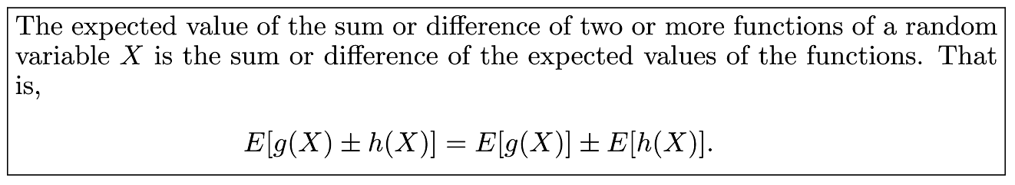
Theorem 4.6

Slide 19
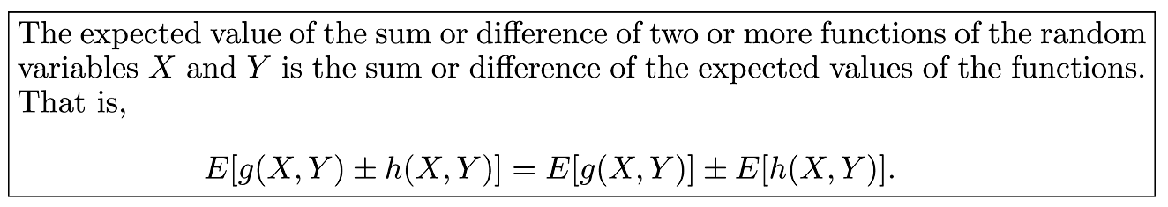
Theorem 4.7

Slide 20
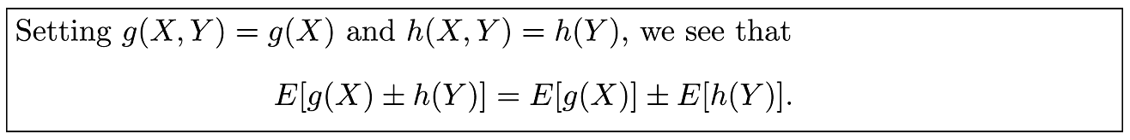
Corollary 4.3

Slide 21
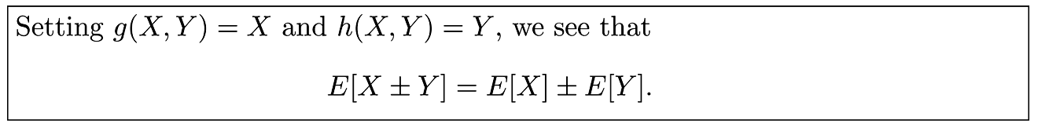
Corollary 4.4

Slide 22
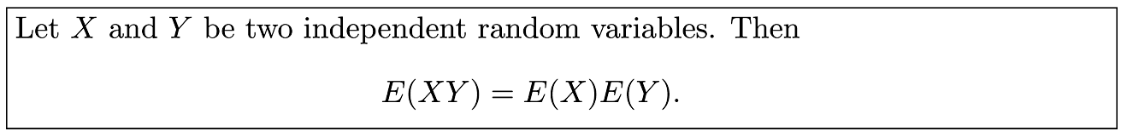
Theorem 4.8

Slide 23
Corollary 4.5

Slide 24
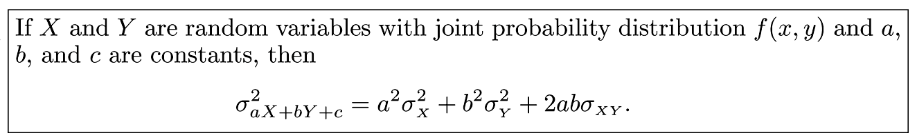
Theorem 4.9

Slide 25
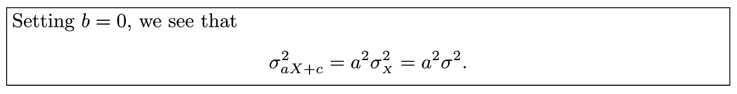
Corollary 4.6

Slide 26
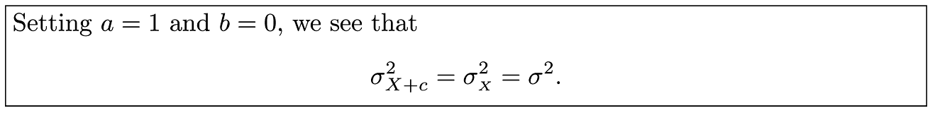
Corollary 4.7

Slide 27
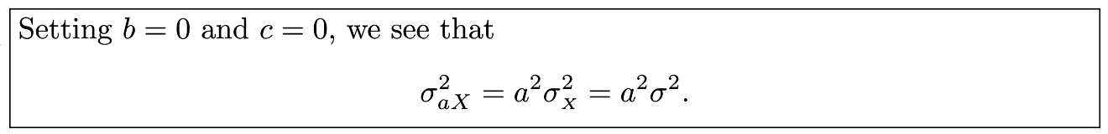
Corollary 4.8

Slide 28
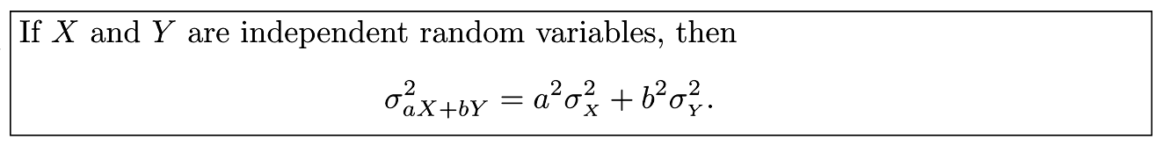
Corollary 4.9

Slide 29
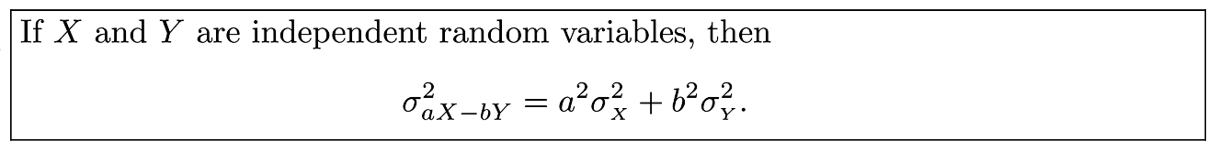
Corollary 4.10

Slide 30
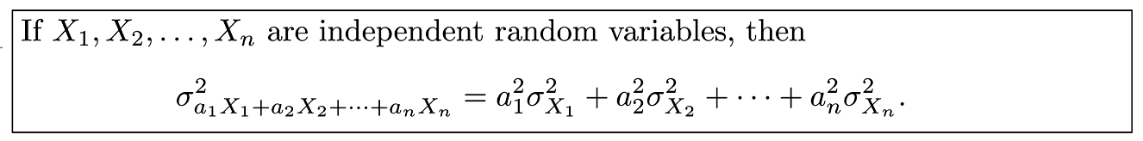
Corollary 4.11

Slide 31
Section 4.4
Chebyshev’s Theorem

Slide 32
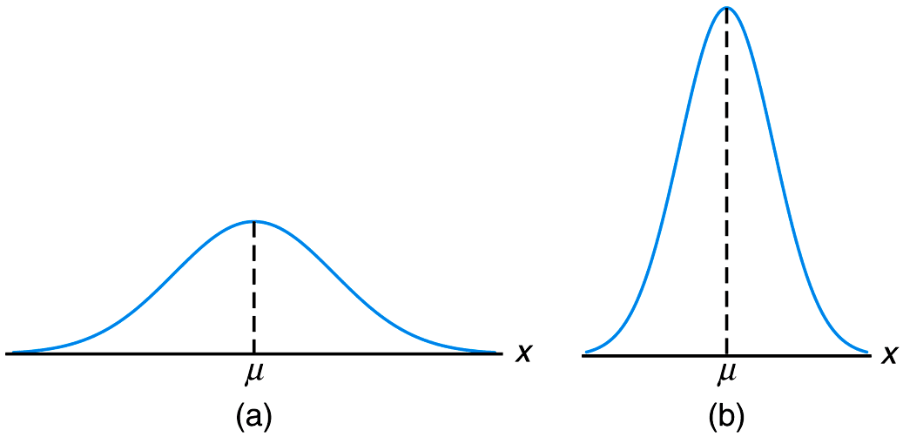
Figure 4.2 Variability of continuous observations about the mean

Slide 33
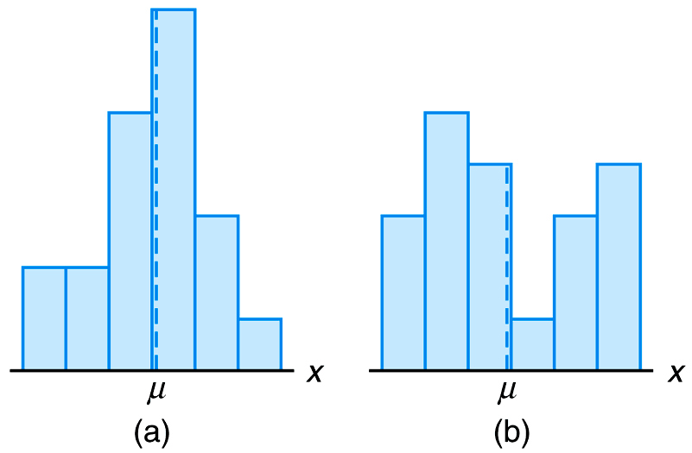
Figure 4.3 Variability of discrete observations about the mean

Slide 34
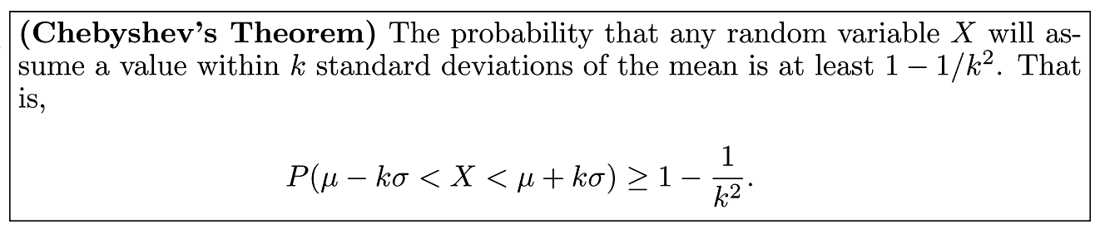
Theorem 4.10

Slide 35
Section 4.5
Potential Misconceptions and Hazards; Relationship to Material in Other Chapters

